Slide 1
Dashboard Design – Task 3
Ayush Rawat

Slide 2
Dataset Overview
This dashboard is based on the Superstore Sales dataset.
Key columns used:
- Order Date
- Region
- Category & Sub-Category
- Product Name
- Sales

Slide 3
Key Performance Indicators (KPIs)
• Total Sales
• Total Orders
• Average Sales per Order
• YoY Sales Growth

Slide 4
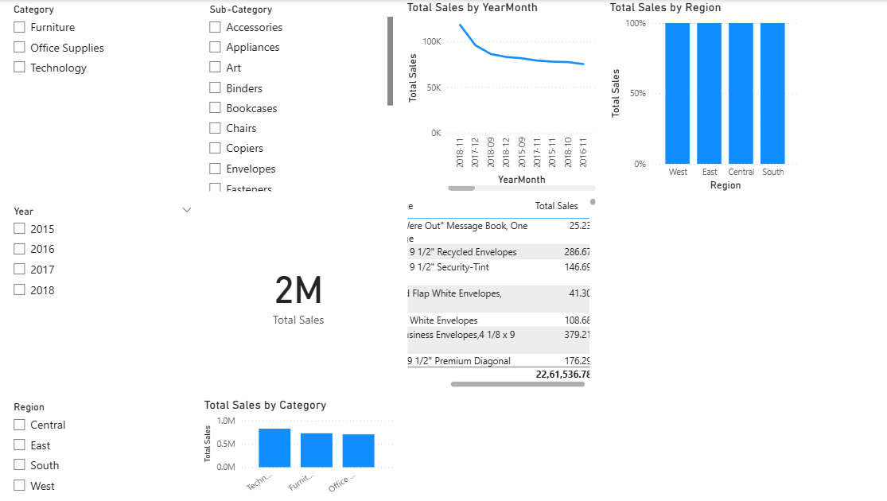

Slide 5
Key Insights
• West region contributes the highest sales.
• Technology is the top-performing category.
• Sales peak during November–December.
• Furniture category shows potential for growth.

